Slide 1

INTELLIGENT HEALTHCARE ASSISTANT FOR EARLY MULTI-DISEASE DETECTION
Team Details:
Names: ASHWINI G (211423104067)
ASMA FARIHA S (211423104069)
Batch Number: A13 Domain: Artificial Intelligence
Guide Name & Designation Coordinator Name & Designation
Dr. M.Maheswari Associate Professor Supervisor Dr. KAVITHA SUBRAMANIAN Professor
Date: 28-10-2025

Slide 2

SDGs and TARGETs
SDG Goal No: 03 – GOOD HEALTH AND WELL BEING.
Goal: Ensure healthy lives and promote well-being for all at all ages
Target 1: Universal Health Coverage.
AI Doctor 2.0 gives easy access to healthcare advice through voice and image, helping people in remote areas.
Target 2: Reduce Deaths from Major Diseases.
The system helps detect diseases like diabetes and heart problems early, which can save lives.
Target 3: Improve Health Risk Management.
It gives health tips and warnings based on symptoms, helping people act early and stay safe.

Slide 3
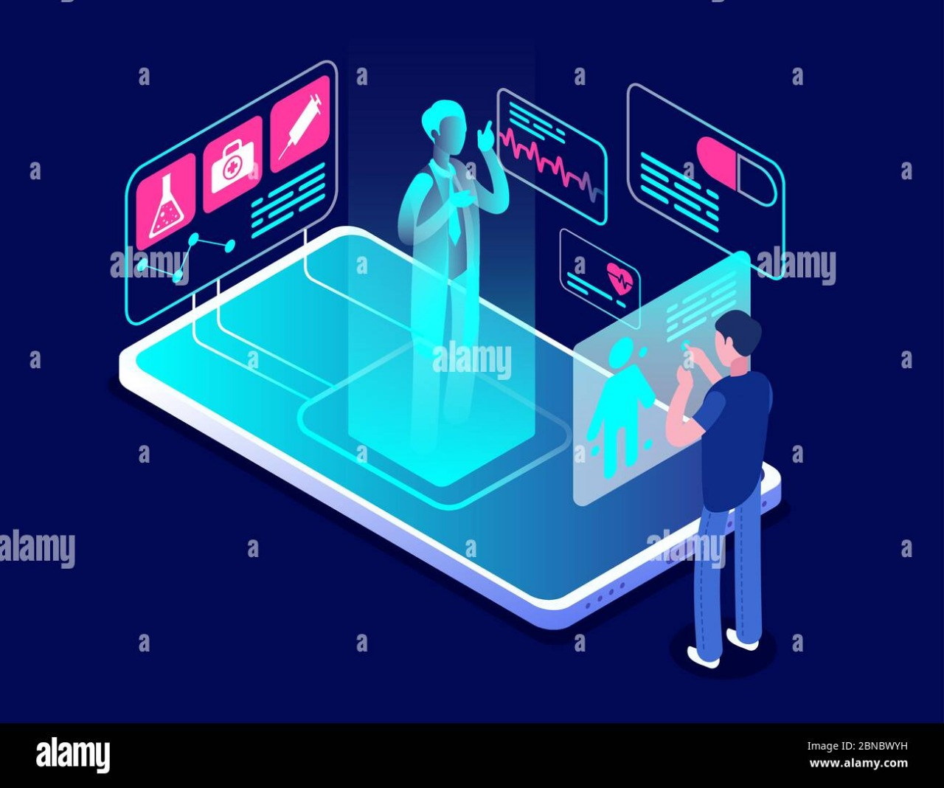
Problem Statement
Most current virtual health assistants are limited to text-based interactions.
They cannot process multimodal inputs like spoken symptoms and medical images.
Lack of personalized, voice-based consultations creates barriers for:
Elderly patients
Illiterate users.
People in remote/rural areas.
Medical image input (like X-rays or skin images) is not supported by traditional chatbots.
There is a critical need for a multimodal chatbot that:
Understands voice commands.
Analyzes medical visuals.
Responds in natural, speech-based form.
Goal: To create a system that mimics real doctor–patient conversations using AI.

Slide 4
Objectives and Significance
Objectives
• To develop an AI-powered multimodal medical chatbot capable of understanding voice, image, and text inputs for interactive healthcare assistance. • To provide accurate symptom-based disease predictions using advanced Large Language Models (LLMs). • To ensure real-time medical guidance and basic health recommendations through natural language conversation. • To integrate speech recognition and text-to-speech for hands-free interaction between patient and AI doctor. • To enhance the accessibility of healthcare information for users in remote or underserved areas.
Significance
• Bridges the gap between patients and healthcare professionals by offering instant, reliable medical support. • Reduces the workload of doctors by handling preliminary health inquiries. • Improves accessibility of medical knowledge through voice and image-based interaction. • Promotes early disease detection using AI-driven analysis of symptoms and medical images. • Supports personalized healthcare, making medical assistance more adaptive, intelligent, and user-friendly.

Slide 5
Social Relevance
• Social Relevance :
This project provides instant and reliable medical guidance, especially for people in remote or underserved areas, improving access to healthcare and promoting early disease detection. It helps reduce the burden on healthcare systems and supports timely, informed health decisions for individuals and families.
• Link to UN SDGs:
SDG 3: Good Health and Well-Being – Ensures healthy lives and promotes well-being through accessible AI-driven healthcare
• Real-World Impact:
Solves the problem of limited medical access and delayed diagnosis by providing fast, reliable, and intelligent AI-based medical assistance. It empowers users with accurate health information, supports preventive care, and contributes to a more equitable and efficient healthcare system

Slide 6
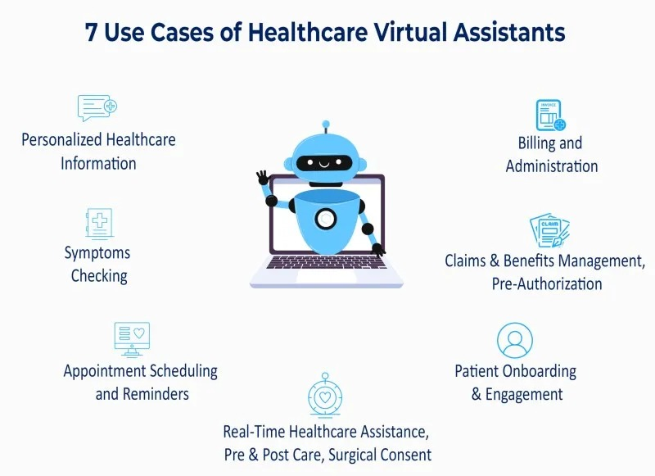
Abstract
Intelligent Healthcare Assistant is an intelligent medical chatbot powered by a Multimodal LLM.
Supports real-time diagnosis using voice input and medical image analysis.
Built with advanced models like Groq inference, Meta’s LLaMA 3 Vision, and OpenAI Whisper.
Allows users to speak symptoms and receive responses through speech + vision-based AI.
Combines STT (speech-to-text), TTS (text-to-speech), and visual recognition.
Developed using Gradio interface for easy and accessible interaction.
Designed for areas with limited access to medical personnel.Supports open-source deployment, with plans for multilingual support and vision model fine-tuning.
Aims to democratize healthcare through real-time multimodal AI assistance.

Slide 7
Research and Literature Review
1. MLtoGAI – Semantic Web + ML + Generative AI (2023)
Aspect | Details
Author | Shyam Dongre et al.
Summary | Proposes MLtoGAI, an AI framework combining Semantic Web, Machine Learning, and ChatGPT for accurate disease prediction and personalized recommendations. Includes disease ontology and SWRL rules for explainability.
Relevance | Integrates explainable AI and semantic reasoning, fulfilling smart healthcare needs for transparent, interpretable disease diagnosis. Aligns with goals of personalized and precise medical recommendations.
Gaps | Not yet deployed in real-world clinical settings. Lacks integration with actual hospital data systems (e.g., EHR). Evaluation done only on synthetic data; real-time performance and scalability unverified.
Impact | Enables explainable diagnosis using ontology and ChatGPT, improving understanding and trust in AI. Paves the way for scalable, user-friendly, and intelligent healthcare systems using semantic AI.

Slide 8
Research and Literature Review
2. Multi-Disease Classifier with Chatbot (DocAI) (2023)
Aspect | Details
Author | Saniya Godikat et al.
Summary | A machine learning-based multi-disease prediction model for diabetes, cancer, Parkinson’s, etc., using logistic regression. Includes “DocAI” chatbot for personalized healthcare advice via Streamlit and Gemini API.
Relevance | Combines prediction and patient interaction, improving accessibility and personalization in healthcare services. Good for non-critical patient engagement.
Gaps | Focuses on basic ML models, lacks integration with real-world clinical systems and lacks deep reasoning like ontology or rule-based AI.
Impact | Makes early-stage health screening more interactive and accessible. Provides user-friendly AI-based consultations through voice/text/image input.

Slide 9
Research and Literature Review
3. Explainable Disease Surveillance Using EHR Data (2022)
Aspect | Details
Author | Shaheer Ahmad Khan et al.
Summary | Proposes a risk surveillance system using routine EHR data to predict 8 chronic diseases (e.g., diabetes, CKD, heart disease) up to 12 months in advance. Uses Random Forest and explainability via SHAP and rule engineering.
Relevance | Addresses the real-world need for predictive, explainable models integrated into EMR systems. Uses routinely collected medical data, improving feasibility for clinical deployment.
Gaps | Focuses only on chronic diseases; no real-time patient interaction or personalized feedback system. Doesn’t use ontology or conversational AI for patient engagement.
Impact | Helps clinicians make informed, proactive decisions. Reduces late diagnoses and improves preventive care, supporting healthcare cost optimization and chronic care planning.

Slide 10
Research and Literature Review
4. AI and IoT-Enabled Diagnosis Using CSO-CLSTM (2022)
Aspect | Details
Author | Romany Fouad Mansour et al.
Summary | Presents a smart healthcare model using IoT-based wearable devices and CSO-tuned CLSTM model for diagnosing diabetes and heart disease. Achieves high accuracy.
Relevance | Emphasizes IoT-AI convergence for smart health monitoring using real-time wearable sensor data, ideal for continuous remote patient observation.
Gaps | Lacks human-understandable explanations (no XAI or chatbot integration). Focused on technical accuracy, not on patient interaction or trust-building mechanisms.
Impact | Offers high diagnostic accuracy (96%+), enabling robust, real-time, IoT-based disease detection systems for smart hospitals and remote care.

Slide 11
Research and Literature Review
5. Alzheimer’s Detection Using Deep ML & IoMT (2022)
Aspect | Details
Authors | Rabia Javed et al.
Summary | Proposes a deep learning model combining U-Net (segmentation) and ResNet-101 (classification) to predict Alzheimer's stages from MRI. Uses IoMT devices and transfer learning.
Relevance | Integrates IoMT and AI for precise, early-stage chronic disease diagnosis (Healthcare 5.0). Tailors well to Alzheimer’s imaging datasets.
Gaps | Focused on Alzheimer’s only; lacks explainable output, chatbot support, or broader chronic disease adaptability.
Impact | Enables early Alzheimer’s detection and staging with high precision (96%), enhancing cognitive care and long-term intervention planning.

Slide 12
Research and Literature Review
6. Healthcare Chatbot – ML + NLP for Medical Help (2024)
Aspect | Details
Authors | Harish BG, PH Priyanka
Summary | Presents a chatbot for appointment scheduling, symptom checking, and health guidance using NLP and ML. Uses TF-IDF, cosine similarity, and n-grams for response generation.
Relevance | Addresses delays and accessibility gaps in traditional healthcare. Designed to assist users with basic queries without medical intervention.
Gaps | Lacks emotional intelligence and real-time learning. Depends on static databases; not integrated with clinical systems.
Impact | Reduces workload on professionals, speeds up help for patients, improves user interaction. User-friendly tool for widespread healthcare support.

Slide 13
Research and Literature Review
7. AI Clinics on Mobile (AICOM) – Mobile AI + SDG3 (2023)
Aspect | Details
Authors | Tim Tianyi Yang et al.
Summary | Proposes AICOM, a mobile-based AI healthcare framework designed for underserved areas without internet. It includes AI-powered diagnosis tools optimized for mobile devices using size reduction, compute and battery efficiency methods.
Relevance | Targets global healthcare disparities by providing offline AI diagnosis. Aligns with UN SDG3 goals to improve health access in least developed countries (LDCs).
Gaps | No integration with real hospital workflows or electronic health records (EHR). Evaluated only on monkeypox using synthetic data. Real-world robustness untested.
Impact | Promotes mobile-first healthcare delivery. Offers privacy-respecting, offline AI diagnosis to hard-to-reach populations, improving access, cost-effectiveness, and global health equity.

Slide 14
Research and Literature Review
8. eHealth Services & SDG3 – Digital Ecosystem & Value Co-Creation (2022)
Aspect | Details
Authors | Jessica Wyllie et al.
Summary | Introduces a framework for eHealth value co-creation using dialogic engagement and activity theory. Case study: eCLiPSE platform for mental health and substance abuse services.
Relevance | Aligns with SDG3 to increase care capacity via digital mental health delivery. Highlights actor readiness and user-provider communication.
Gaps | Lacks real-time emotional adaptation. Adoption challenges remain due to clinician resistance and user attrition in digital services.
Impact | Encourages stakeholder participation and design of inclusive digital ecosystems. Enhances long-term engagement and accessibility in mental health care.

Slide 15
Research and Literature Review
9. HHH – Knowledge Graph + HBAM Medical Chatbot (2020)
Aspect | Details
Authors | Qiming Bao et al.
Summary | Introduces HHH, a hybrid chatbot system combining a medical knowledge graph with a Hierarchical BiLSTM Attention Model (HBAM) to answer complex healthcare questions.
Relevance | Tackles challenges in online healthcare support using a scalable QA framework. Improves semantic understanding and response precision in medical chats.
Gaps | Limited to text-based queries and preset domains. No emotional intelligence or speech-based interaction. Cannot handle vague or highly contextual questions.
Impact | Delivers accurate healthcare Q&A, outperforms BERT and MaLSTM in medical domains. Enhances access to medical guidance via a structured and intelligent chatbot system.

Slide 16
Research and Literature Review
10. EMMA – Emotion-Aware mHealth Chatbot (2019)
Aspect | Details
Authors | Asma Ghandeharioun et al.
Summary | EMMA is an emotionally intelligent chatbot that delivers mood-based wellness interventions via mobile phones. Detects emotion via location and context data using ML.
Relevance | Pioneers personalized mental wellness through just-in-time interventions. Bridges gaps in affect-sensitive healthcare delivery.
Gaps | Limited to Android phones, depends heavily on sensor data, lacks speech interaction. Needs broader validation in clinical use.
Impact | Improves user engagement through emotion-aware dialogues. Enables personalized micro-interventions for well-being using real-time affect sensing.

Slide 17
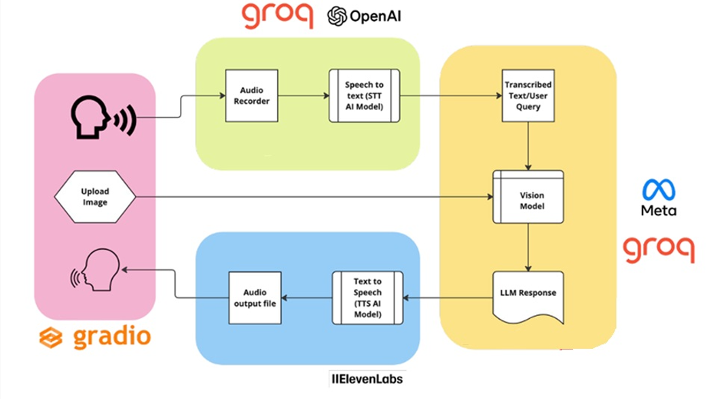
Product Architecture and Design/ Block Diagram

Slide 18
System Architecture Overview
Input Layer (Gradio Interface): • Users interact through voice or image input. • Voice is recorded using an Audio Recorder, and images are uploaded for visual analysis.
2. Speech Processing (Groq + OpenAI): • The Speech-to-Text (STT) model converts spoken input into text using Groq’s high-speed AI inference. • The transcribed text or user query is then sent for analysis.
3. Vision and Language Understanding (Meta + Groq): • The Vision Model processes uploaded medical images to extract relevant visual information. • Both text and image data are analyzed by the LLM (Large Language Model) to generate an intelligent medical response.
4. Output Generation (ElevenLabs): • The Text-to-Speech (TTS) model converts the AI’s text response back into voice output. • The audio output file is played back to the user via the Gradio interface.
5. Workflow Summary: Voice/Image → STT → Vision & LLM Processing → Text Response → TTS → Voice Output

Slide 19
Software specifications
• Operating System: Windows 10 / 11
• Programming Language: Python 3.10+
• Frameworks & Libraries:
Groq API – for LLM and Speech-to-Text processing
ElevenLabs / gTTS – for Text-to-Speech
Gradio – for web-based user interface
• Tools & Environment:
VS Code

Slide 20
Justification for POSITIVE
• Provides instant medical assistance, improving accessibility for people in rural and underserved areas. • Encourages early detection and prevention of diseases through AI-based symptom analysis. • Reduces patient waiting time and the burden on healthcare professionals. • Promotes health awareness and self-care, empowering users to make informed decisions. • Contributes to digital healthcare innovation, aligning with global goals for affordable and inclusive healthcare.

Slide 21
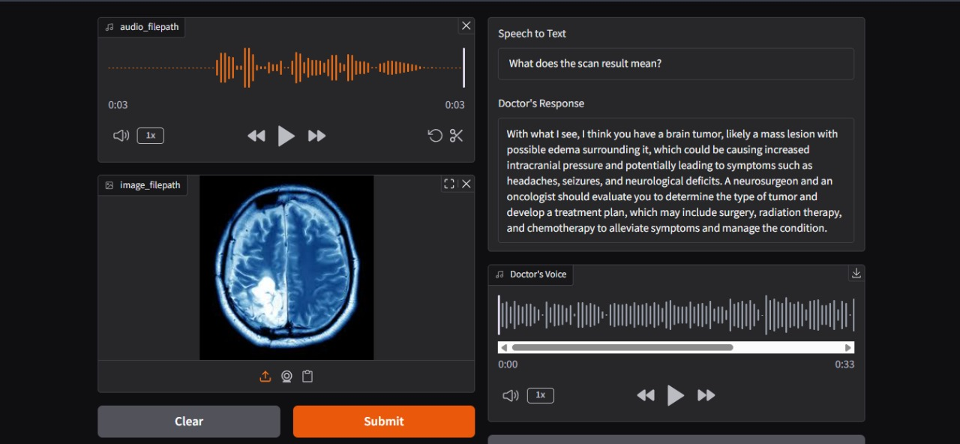
Experimental Results

Slide 22
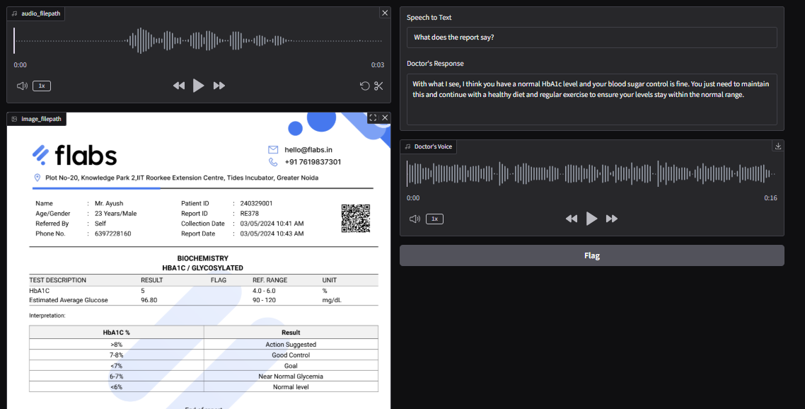
Experimental Results

Slide 23
Project Showcase and Future Steps
Project Showcase:
• Demonstrates a multimodal AI healthcare chatbot that understands voice, text, and images. • Provides real-time medical guidance and basic disease prediction using LLM and Vision models. • Integrates Speech-to-Text (STT), Text-to-Speech (TTS), and image analysis for interactive communication. • User-friendly Gradio interface enables seamless interaction between patients and the AI system.
Future Steps:
• Add multilingual support to reach non-English users. • Develop a mobile application for wider accessibility. • Integrate with Electronic Health Records (EHRs) for personalized care. • Include real-time doctor consultation and follow-up reminders. • Enhance the knowledge base with continuous medical research updates

Slide 24
Conclusion
The project demonstrates the potential of Artificial Intelligence in healthcare by creating an intelligent, multimodal medical chatbot that can analyze voice, image, and text inputs. By integrating Large Language Models (LLMs), Groq inference, and Gradio-based interaction, the system delivers accurate and context-aware medical guidance to users.
The chatbot enhances accessibility to healthcare, especially for people in remote or underserved areas, offering instant medical assistance without the need for physical consultations. It promotes early detection, prevention, and awareness, empowering users to take proactive steps toward better health.
Through continuous learning and updates, the system can evolve into a comprehensive AI healthcare companion, capable of handling complex queries and supporting healthcare professionals. Overall, this project highlights how AI can bridge the gap between technology and medicine, fostering a future of affordable, efficient, and inclusive digital healthcare.

Slide 25
Reference
Dongre, S., & Chaudhari, R. (2024). MLtoGAI: Machine Learning to Generative AI using Semantic Web for Disease Classification with Personalized Recommendations. arXiv preprint arXiv:2407.20284.
2. Khan, S. A., et al.(2024). Explainable disease surveillance with routine electronic health record data: predicting risk 3, 6, and 12 months in advance. npj Digital Medicine, 7(1), 1–12.
3. Godikat, S., & Chouhan, V. (2024). AI based Medical Chatbot using Machine Learning Algorithm. International Journal for Research in Applied Science and Engineering Technology, 12(5).
4. Radford, A., et al. (2023). Whisper: Robust Speech Recognition via Large-Scale Weak Supervision. OpenAI.
5. Meta AI Research (2024). LLaMA 3: Open-Source Foundation Models. Meta Platforms, Inc.

Slide 26
Thank You!

